Slide 1
REMONDIS’ Lippe Plant. The home of recycled raw materials
remondis-lippe-plant.com

Slide 2
Type of enterprise: Family-run company | Fields of business |  | > 800 locations in over 30 countries around the world
> 30,000 employees | 8,000 company-owned commercial vehicles | > 800 plants & facilities | > 500 locations across all German states
> 30m tonnes raw materials/year | EfB accreditation: All business locations | > 30m people benefit worldwide | > 200,000 industrial & commercial customers
Recycling
Services
Water
Recycling
Service
Wasser
As of: 06_2017

Slide 3
The Group: Four divisions offering specialised services and products.
*
Environmental & Technical Services
Recycling
Services
Water
Transport services
Urban and intercity public transport
Mass rail transport
On-demand transport
Logistics
Contract Logistics
Freight Logistics
Port Logistics
Bio-Industries
High-quality goods from animal by-products
Producer of renewable energy
Service provider for the agricultural and food sector
Turnover 2017 million €: | 7,300 |  | Turnover 2017 million €: | 6,643 |  | Turnover 2017 million €: | 2,800 |  | Turnover 2017 million €: | 2,300
Employees 2017: | 34,000 |  | Employees 2017: | 82,000 |  | Employees 2017: | 29,000 |  | Employees 2017: | 9,000
* 34% share

Slide 4
It looks like an industrial plant, but has the same effect as 25,000ha of forest

Slide 5
A site steeped in tradition. With a great future ahead of it
The large-scale operations at Europe’s largest industrial recycling centre help conserve natural resources and tackle climate change.
> A few facts & figures
Total area | 230ha
No. of employees | 1,400 (… and counting)
Input residual materials | around 1.4m tonnes*
Output raw materials | around 1.4m tonnes*
Output energy | 336,900 MWh*
CO₂ emission savings | 488,000t*
* per year
Find out more at > remondis-lippe-plant.com

Slide 6
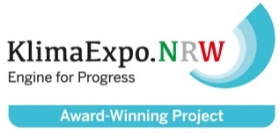
Recovered today – Reused tomorrow. Our mission: working for the future
REMONDIS’ Lippe Plant is an excellent example of how recycling can help counter climate change
A study, drawn up by Prognos AG and the INFA Institute, has shown that the activities at the Lippe Plant reduce carbon emissions by almost half a million tonnes every year.
KlimaExpo.NRW, a project organised by the State Government of North Rhine-Westphalia, has named the Lippe Plant as one of the best projects to have a sustained beneficial impact on our climate

Slide 7
Sustainable work that prevents bad things happening
Every year, the Lippe Plant effectively offsets the carbon emissions produced by 80,000 passengers taking long-haul flights from Germany to Sydney
* acc. to a study by Prognos AG & the INFA Institute

Slide 8
The Top 5 carbon cutters at REMONDIS’ Lippe Plant
- 32,000
Production of sodium aluminate
Production of binding agents
WEEE recycling
Timber processing // biomass-fired power plant
Production of biodiesel
- 36,000
- 42,000
-145,000
-152,000
Vol. of carbon emissions cut per year in tonnes // as of 06_2016

Slide 9
13
11
10
12
15
13
9
6
8
7
14
16
5
4
17
3
1
2

Slide 10
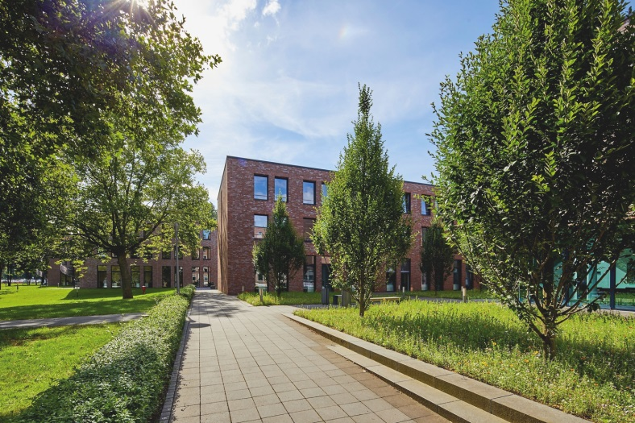
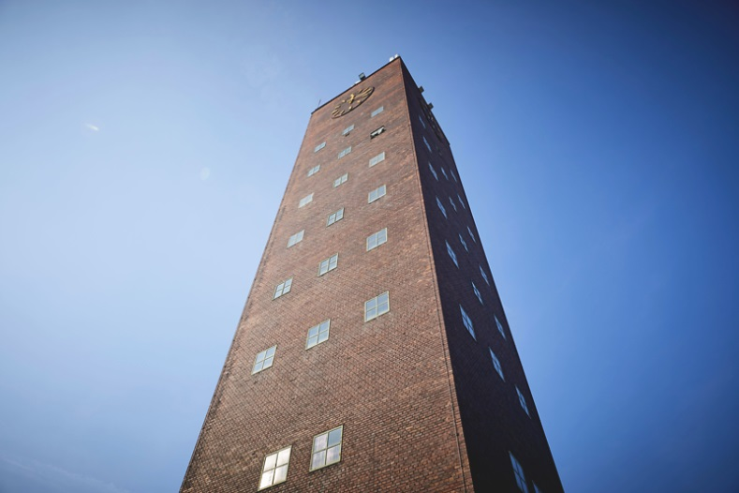
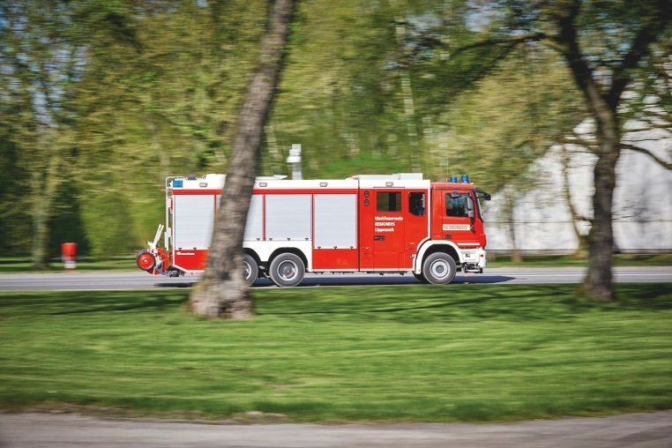
A recycling centre with a perfect infrastructure
01 Main administration buildings
All of the Group’s national and international activities are coordinated from here
02 Water tower
The water tower is 51 metres high and has enough space to store 300m³ of drinking water and 300m³ of raw water
03 Plant security & fire station
Top priority is given to safety & security at the Lippe Plant. From the checks on the incoming materials, to the protection provided by the site’s own fire brigade

Slide 11
04 Metal slag processing
Input: slag & spent refractories from producing high-grade steel / spent refractories from the copper industry
Output: high-grade steel & non-ferrous metal granulate *
Use: a raw material for producing high-grade steel and copper products
* Most recycled materials are returned to the original customers

Slide 12
05 Disposal of high risk animal by-products
Input: abattoir by-products, fallen animals from farms
Output: refuse-derived fuel, fat
Use: fat for producing biodiesel, fuel for thermal treatment

Slide 13
06 Treatment of organic waste (incl. earthworks)
Input: plant & tree cuttings from gardens / parks, contents of organic waste bins
Output: compost products – RETERRA brand // energy (electricity, process steam)
Use: e.g. as an organic NPK fertiliser, soil improver, plant substrate, mulch substrate, soil cover // fed into the grid to supply electricity as well as to cover the facility’s own needs

Slide 14
07 Production of biodiesel
Input: vegetable & animal fats, old cooking fats (plus other auxiliary materials and raw materials)
Output: ecoMotion® biodiesel, glycerine, fertiliser, bio heating oil
Use: biodiesel is e.g. used by mineral oil companies to meet the statutory greenhouse gas quota

Slide 15
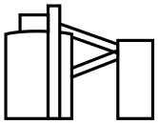
08 Production of binding agents
Input: FGD gypsum, chemical gypsum
Output: additives & binding agents – RADDIBIN brand
Use: the gypsum-based products are processed into liquid screed and porous concrete, fertilisers and cement as well as materials used in dentistry

Slide 16
09 Production of sodium aluminate
Input: sodium aluminate solutions, acids, filter cake, sludge
Output: sodium aluminate from the ALUMIN product family
Use: as an extremely pure specialty chemical in sewage treatment plants, the chemicals industry and construction chemicals

Slide 17
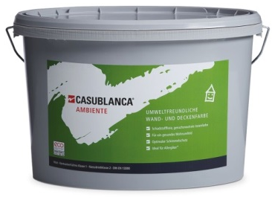
10 Production of white minerals
Input: incl. ALUMIN and other high quality raw materials
Output: the white mineral CASUL
Use: raw material for the paint industry (organic dispersion paint / CASUBLANCA® brand), paper industry (refining high quality paper) & construction chemicals (liquid plaster)

Slide 18
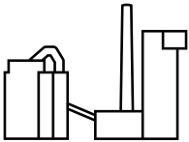
11 Fluidised-bed power station
Input: refuse-derived fuel such as sterilised meat paste, animal meal, waste from the chemical & pharmaceutical industries, sewage sludge etc
Output: energy (electricity, process steam & compressed air)
Use: supplies energy to the production facilities at the Lippe Plant

Slide 19
12 Transfer centre for medical waste
A modern logistics centre for storing, transhipping & treating waste
It has a very large storage area to compensate for possible shutdowns or malfunctions at the treatment facilities that the centre works with
Guarantees waste can always be collected from the customers whenever required

Slide 20
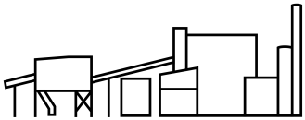
13 Timber processing & biomass-fired power plant
Input: A I – A IV wood, screen overflow
Output: refuse-derived fuel from biomass, wood chips for materials recycling, e.g. to produce chipboard
Use: to generate electricity in the biomass-fired power plant → fed into the grid to cover the requirements of approx. 45,000 households

Slide 21
14 Plastics recycling
Input: jerry cans, drums, bottles, pipes, buckets, containers, production rejects, moulded parts, mixed plastics from the fridge/freezer dismantling operations
Output: granulates / compounds, e.g. the PLANOLEN & PLANOMID brands
Use: as a raw material for producing e.g. fans, switch boxes, ventilation systems, vehicle parts, Rawlplugs and casing for electrical appliances

Slide 22
15 Second-use battery storage unit
The site’s battery storage unit was first commissioned in 2016 and is one of the largest in the world
Lithium ion batteries from electric drive vehicles are used here as a flexible source of energy
At full capacity, it can hold ca. 1,000 batteries and supply electricity when it is needed, e.g. if there is a sudden dip in electricity supply

Slide 23
16 Umwelt Control Labor
Environmental analyses, production monitoring measures & quality control
Analysis of water, soil & air in acc. with laws and regulations
Services for engineering firms, public authorities, chemicals / construction businesses & the recycling sector
Nationwide operations; central laboratory in Lünen
Analysis methods: ca. 1,000,000 p.a.

Slide 24
17 WEEE recycling
Input: discarded electrical & electronic equipment incl. fridges and screens
Output: non-ferrous metals, ferrous metals, glass, plastics
Use: raw materials for metal processors, shredder businesses, ironworks, aluminium plants, plastics processors

Slide 25
Working together for the greater good. Synergies at the Lippe Plant
1
2
3
Biomass
High risk animal by-products
E-waste
organic waste treatment
disposal plant
WEEE dismantling plant
Recycled product: high quality composts & soils
Recycled product: metals separated acc. to type
energy recovery
Residual materials: separated wood
Residual materials: animal fat
Residual materials:
mixed plastic waste
timber processing
biodiesel production
plastics recycling
Recycled product: refuse derived fuel (RDF)
Recycled product:
eco-friendly fuel
Recycled product:
plastics separated acc. to type
biomass-fired power plant
RDF transformed into electricity

Slide 26
Are there any questions?
Find out more at > remondis-lippe-plant.com
REMONDIS SE & Co. KG
Brunnenstr. 138
44536 Lünen // Germany
T + 49 2306 106-0 // remondis.com
remondis-lippe-plant.com

